Slide 1
Together we can – military
Program adaptation
Hilary D. Pippert, Anthony J. Ferraro, Lindsey D. Hamner
Kansas state university
NCFR - Nov 2019
Annual Meeting of the National Council on Family Relations
November 2019 | Fort Worth, TX
Annual Meeting of the National Council on Family Relations
November 2019 | Fort Worth, TX

Slide 2
Together we can (TWC): background
Primary Issues for Military Families
Weekly meetings over 7 weeks
Designed for single or struggling parents
Implemented in civilian community settings nationwide
Coparenting curriculum focusing on
Goal setting
Dual-parent involvement
Healthy communication
Inconvenient and not practical
Does not involve children
Does not address military-specific experiences
Many military families live on base
Missing content on financial management
Notes:
military families have financial constraints; often both parents have to work to pay the bills and need help with managing income; in military life have times of extra bits of income from random places depending on assignment, where you live, and how many people are in the family –

Slide 3
TWC – military: development
As of 2015, over 1 million active duty U.S. service members (Parker et al., 2017)
Civilian & military-life stressors (Blaisure et al., 2012)
Blue Star Families identified 3 top issues
Time away from families
Impact of deployment on children
Military family quality of life

Slide 4
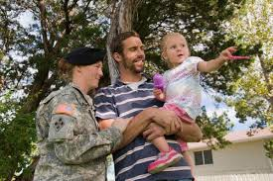
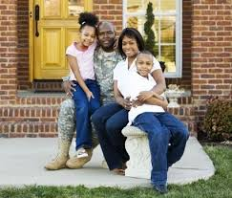
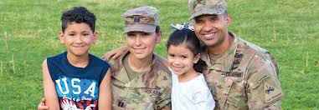
Target audience
Families with at least one parent who holds active duty status in the U.S. military
Enlisted and officers in different retreat groups
Initial design & population for pilot:
Active duty US Army
Families with at least one child between 7 and 15
Notes:
Active duty because this is the population that is in the middle of experiencing military stressors and has more to gain from this type of program than veterans – yes they may be harder to contact and work with than veterans, but the design of this program is purposeful in making it as easy for active duty members and their families to participate
Children age – 7-15 for a couple reasons: this is an age where children may have great difficulty with military life and engage more often in comparative thought processes that contribute to making this stage of life difficult for them and their families (also, Strengthening Families program focuses on children in this age range;

Slide 5
Program & Goals Integration
Integrated Programs
Together We Can (TWC)
Parent-focused
Life Ties (LT)
Military-focused
Survive, Strive, Thrive (SST)
Family-focused
Overarching Army Values
Duty
Honor
Loyalty
Respect
Integrity
Selfless Service
Personal Courage
Overarching Program Goals
Readiness (LT)
Mindfulness (TWC, LT)
Problem solving (SST, LT)
Stress management (SST, TWC, LT)
Strengthening family relationships (TWC, SST, LT)

Slide 6
TWC – Military program overview
 | CULMINATING ACTIVITIES
MODULE | Parents | Children
Goal Setting | Writing SMART goals in retreat diary Create family goals on a poster
Healthy Relationships | Parents identify family activities can do with Soldier and when Soldier is gone | Children will make cards for parents and siblings to communicate love for them
Communication Skills | Parents practice “I” messages and listening skills with different practical role play scenarios | Games (e.g., Charades and Landmines)
Stress & Conflict Managing | Make stress balls as part of stress survival box
Problem Solving | Family works together to learn to play a new game
Parenting Skills | Complete the “Identifying Your Par. Style” handout | Choice of activities
Finances | Parents start working on a money management plan and family budget | Choice of activities
Military vs Civilian Life | TBD | Choice of activities
Family Roles/S&I Families | Relay Race
Self-Care | Practice self-care techniques

Slide 7
TWC – Military overview
Module: Goal Setting – All family members
Individuals/ Families use goal-setting principles to implement a plan for their future military experiences
Learning Objectives
Understand what goal setting is and why it’s important
Set goals for the retreat and long-term goals
Identify steps needed to achieve these goals
Notes:
M1. Be aware of how the self is progressing through life.
R1. Recognize that setting goals facilitates readiness (across all areas of life).
M2. SM1. Setting goals is another tool to manage stress and be more prepared for potentially stressful circumstances.
PS1. SM2. Be able to use goal setting principles to guide solving problems that arise.

Slide 8
TWC – Military overview
Module: Healthy Relationships
Parents
Children
Parents live and demonstrate healthy relationships with each other to actively teach children how to develop healthy relationships
Children build healthy relationships with those around them (family members and friends)
Learning Objectives
Children understand how to interact with others in healthy ways
Children strengthen their positive relationship building skills
Children find happiness in having relationships with family members
Learning Objectives
Parents understand characteristics of healthy relationships
Parents have skills they can use to increase the positivity and love within their family relationships
Notes:
Parents:
M4. SF2. Parents are mindful of how they foster or hinder healthy relationships, specifically within their families.
SF3. Parents strive to exemplify healthy family relationships, thereby strengthening them.
SM4. Parents are able to build healthy relationships with each other and with children, lessening the amount of stress from family life they may feel.
Children:
M5. Children are mindful of how their actions influence their family relationships.
SF4. Children put forth efforts to build healthy family relationships.
SM5. Children are able to better handle stress when they have healthy family relationships (have a built in support network).

Slide 9
TWC – Military overview
Module: Communication Skills
Parents
Children
Parents will practice healthy communication patterns with each other and with their children to increase their family strength
Children will practice healthy communication patterns with family members, contributing to family strength
Learning Objectives
Identify and practice components of effective communication
Use effective listening skills
Know importance and benefits of “I” messages
Learning Objectives
Increase listening skills and abilities
Be able to use a good “I” message in a conversation
Notes:
Parents
SF8. PS4. SM8. Family members will be able to communicate more effectively thereby increasing family cohesiveness, decreasing potential stress, and increasing the ability of family members to problem solve effectively together.
SF9. By learning how to use active listening and responding skills, family relationships will be strengthened because of increased understanding.
PS5. By learning how to use active listening and responding skills, family members will be more effective at problem solving.
PS6. SM9. By learning how to use “I” messages, family members will be able to problem solve more effectively with decreased levels of stress.
Children
M10. Children will be aware of their communication patterns and how to improve them.
SF10. Children will be able to better communicate with family members, which will strengthen trust within the relationships.
PS7. SM10. Children will be able to communicate effectively about problems, which can help lessen stress that comes from conflict.
R6. Children will be prepared to discuss hard things

Slide 10
TWC – Military overview
Module: Stress & Conflict Managing – All Family Members
Family members feel able to manage conflict and stress in their homes in healthy ways
Learning Objectives
Recognize how stress and conflict can be harmful in family relationships
Have tools to decrease and handle stress
Have tools to avoid and manage conflict
Notes:
SM13. Family members will practice skills to manage conflict and stress in healthy ways.
M13. By understanding the harmful effects of stress and conflict, family members will be able to engage in self-monitoring as a way to help them avoid ‘breaking points’ and manage stress and conflict in healthy ways.
R9. Being equipped with stress management skills, military family members will be able to manage the regular aspects of military life that can often be stressful while experiencing less stress than what may be ‘normal’ in the given situation.

Slide 11
TWC – Military overview
Module: Problem Solving Family Activity – All Family Members
Help military families understand how to best solve any problems that may arise
Learning Objectives
Learn how to identify problems
Make positive decisions to solve problems
Feel competent at being able to solve problems
Notes:
SF11. PS10. Families will believe and have confidence that they can solve things together in positive ways and be stronger as they do so.
R8. Families will understand that problems will always come up and will be prepared with skills to solve these problems.
SM12. Families will be able to practice problem solving skills in ways that will decrease stress resulting from problem situations.

Slide 12
TWC – Military overview
Module: Parenting Skills – Parents
Parents increase knowledge and practice of positive parenting skills
Learning Objectives
Parents understand varying positive parenting skills
Parents come away with strategies to better parent each child specifically
Parents increase the tools in their parenting toolbelt
Notes:
M6. Parents are aware of the parenting decisions they are making and whether they are positive or negative.
M7. SF5. Parents are aware of positive parenting skills/strategies to use that will also foster family relationships.
R4. PS3. Parents will be ready to handle parenting challenges and experiences with increased knowledge of positive parenting skills.
SM6. Parents will be able to better manage their parenting stress because of their increased knowledge base of good parenting.

Slide 13
TWC – Military overview
Module: Finances – Parents
Help military families practice healthy spending and saving behaviors
Learning Objectives
Be able to differentiate between a financial need and a financial want
Know how to create a financial plan that the parents can work together to accomplish
Have more knowledge about money tracking tools and saving strategies
Notes:
M11. Be mindful of where their money is going.
M12. Be mindful of where they want their money to go and how to save for those things.
R7. SM11. PS8. Be able to implement saving strategies to prepare for future emergencies.
PS9. Know military resources available to help with finances.

Slide 14
TWC – Military overview
Module: Differences Between Military & Civilian Life – Parents
Help decrease the stress military families often feel when transitioning into civilian life (whether forced or chosen), while increasing their readiness for this transition
Learning Objectives
Are informed about the differences between military and civilian life and what obstacles they may face during that transition
Are better equipped to manage stressors that come with transitioning into civilian life
Parents start having conversations about how to address some of the transitions for their specific family
Notes:
M3. R2. Be aware of the differences between military and civilian life.
SM3. PS2. R3. Start discussing with partner/family about how their family may be impacted by transitioning into civilian life ahead of when that transition may occur.
SF1. Families will be stronger as they prepare for hard experiences together.

Slide 15
TWC – Military overview
Module: Family Roles/Strong & Intentional Families – All Family Members
Help families feel they can be strong through intentionality despite what happens with military life
Learning Objectives
Identify and understand qualities that make families strong
Identify the qualities that make their family strong
Notes:
SF6. M8. Be aware of what makes their family strong, contributing to strengthening family relationships.
SF7. M9. Be aware of what roles each person wants to fill and is responsible to fulfill so that expectations can be clear and the family can better work together to be successful.
R5. By identifying the strengths of their family they will know what resources are available to them and where they might need to ask for outside resources or help.
SM7. By identifying family strengths and understanding what roles each person fills, the family will be better prepared to manage potential stress (including military stressors).

Slide 16
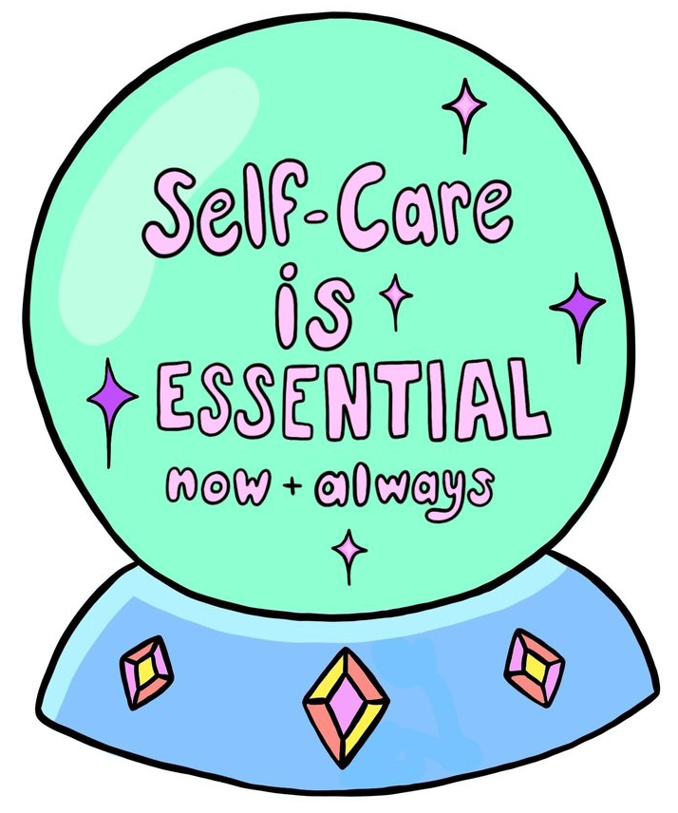
TWC – Military overview
Module: Self-Care – All Family Members
Help family members experience the benefits of self-care and commit to self-care practices post-retreat
Learning Objectives
Understand and recognize the importance and benefit of self-care
Recognize that there are many things that count as self-care
Have many self-care strategies in one’s toolbelt
Notes:
M14. R10. Family members will be aware of when they need to engage in self-care activities (in mental and physical ways) to be able to healthily manage everything else going on in their lives and what unexpected situations may arise.
SM14. Family members will manage stress through engaging in self-care activities.
SF12. Family relationships can be strengthened as family members better understands what each member needs to practice good self-care and how they can support each other in these goals.
PS11. By practicing self-care behaviors, family members will be able to think more clearly when needing to problem solve.

Slide 17
TWC– Military: Evaluation
Demographic Information
Military Status Information
Mindfulness:
Baer et al. (2006); Mindfulness Scale
Stress Management:
Walker et al. (1995); HPLPII Stress Management Scale
Problem Solving:
Walsh (2003); Family Resilience Assessment Scale, Communication: Problem-Solving subscale
Readiness:
Walsh (2003); Family Resilience Assessment Scale, Belief systems: Positive outlook * Organizational Patterns: Flexibility subscales
Strengthening Family Relationships:
Walsh (2003); Family Resilience Assessment Scale, Organizational Patterns: Connectedness subscale
Pre-Retreat Survey – Parents
Post-Retreat Survey – Parents
6-month Follow-up Survey - Parents

Slide 18
Thank you!
Questions can be directed to Hilary Pippert
Kansas State University
dhilary@ksu.edu
References are available upon request
Annual Meeting of the National Council on Family Relations
November 2019 | Fort Worth, TX
Annual Meeting of the National Council on Family Relations
November 2019 | Fort Worth, TX

