Slide 1
A comparison of U.S. military veterans’ & civilians’ leisure participation & its association with psychological adversity & health care visits among older adults _____________________________________________________________________________________________________________________________
FRIENDS
of the
Tallgrass
University
of
Arkansas
Kansas
State
University
University
of
Iowa
James M. Duncan, Ph.D., CFLE, DAV, University of Arkansas, jmduncan@uark.edu
Anthony J. Ferraro, Ph.D., CFLE, Kansas State University, aferraro@ksu.edu
Kayla Reed-Fitzke, Ph.D., LMFT, University of Iowa, kayla-fitzke@uiowa.edu
Timothy S. Killian, Ph.D., University of Arkansas, tkillian@uark.edu
NCFR
Ft. Worth Nov 2019

Slide 2
The Aging Population
As of 2015 it was estimated that there were nearly 47.8 million individuals age 65 & older in the U.S.
Some older adults experience declines in cognitive function
Other older adults experience declines in physical functioning
When examining health outcomes & the impact of aging, an important population to consider are U.S. military veterans
Military populations generally have poorer mental health, physical health, and health behaviors than civilians
Alexandre et al. 2014; U.S. Census Bureau, 2017; Kessler et al., 2014
Hoerster et al. 2012, McKhann et al., 2011
Notes:
Projections are older adult numbers will double over the next fourty years
Some older adults experience declines in both physical and cognitive functioning

Slide 3
Current Study
The subpopulation of aging veterans with a higher propensity for adverse health outcomes will continue to grow
We investigate if & how social leisure is associated with psychological adversity & health care visits among older adults
Alexandre et al. 2014; U.S. Census Bureau, 2017; Kessler et al., 2014
Hoerster et al. 2012, McKhann et al., 2011
Notes:
Bullet one: Considering the growing military population, as evidenced by recruitment statistics subpopulation of aging veterans with a higher propensity for adverse health outcomes will continue to grow
Bullet two: in an effort identify mechanisms that can promote optimal functioning through the aging process

Slide 4
Why Social Leisure?
Social leisure helps to integrate individuals with meaningful others through participation in shared social activities where acts of social support & social influence can be expressed
Lack of social integration has been linked to low levels of social support & higher psychological adversity
High levels of social integration is associated with positive perceptions of social influence to seek out & utilize health care
Thoits, 2011; Coyle & Dugan, 2012; Hatch et al., 2013;
Spoont et al., 2014
Notes:
Prior research is very noteworthy based on previous literature on older adults and older adult veterans

Slide 5
Hypotheses
H1: (social leisure as a predictor):
It was expected that higher social leisure participation, would be associated with lower psychological adversity &, in turn, those with high psychological adversity would report higher health care visits
H2: (veteran status as a moderator):
It was expected there would be significant differences on all study variables, social leisure as well as psychological adversity and health care visits, between individuals who identified as having veteran status versus those identified as civilians

Slide 6
Measures
Social Leisure Participation
Predictor measured with three items, how often did you…
“Volunteer work for religious, charitable, political health-related, or other organizations?”
“Attend meetings of any organized group?”
“Get together socially with friends or relatives?”
Time 1: α=.64; Time 2: α=.69
Psychological Adversity
Latent variable measured by anxiety, depression, & stress
7-item reduced version of the Hospital Anxiety & Depression Scale
4-item reduced version of the Perceived Stress Scale
Time 1: α=.70; Time 2: α=.71
Health Care Visits
Outcome variable measured by a single item
Measured by asking over a 12-month period
How many times have you seen a doctor/health care professional about your health at a doctor’s office, a clinic, hospital emergency room, at home or some other place
Veteran Status
A single item was used to assess moderation
“Have you ever served in the active military of the United States?”

Slide 7
Analytic Sample
The data used for this study originated from waves one & two of the National Social Life, Health, & Aging Project
Representative longitudinal study of individuals over the age of 57
Participants among the analytic sample
Time 1=1,194 & Time 2=809
35.1% identified as having prior military service
56% of the sample was male
Majority identified as White (78.7%)
59.6% were between the ages of 65-74
40.4% were between the ages 75-85
60.2% married
82.0% had a high school diploma or higher education
Waite et al., 2010-2011;
Waite, Laumann, Levinson, Lindau, and O’Muircheartaigh, 2005-2006
Notes:
NSLHAP Original data collection occurred in a face-to-face format by researchers from the University of Chicago, who asked questions exploring social relationships, physical health, cognitive health, & health behaviors of older adults

Slide 8
Analysis
SEM fitted in AMOS 26 using FIML
Control variables:
age
gender
education level
physical functioning level
relationship status
ethnicity
Several fit indices used:
Normed Fit Index (NFI)
Comparative Fit Index (CFI)
Tucker-Lewis index (TLI)
root mean error approximation (RMSEA)
Sobel test was used to examine indirect effects
Notes:
A series of path models were fitted in AMOS 26 using full information maximum likelihood
Fit indices In general, NFI, CFI, and TLI between .90 & .95 indicate adequate fit & above .95 indicate good fit, & rmsea values below .05 indicate good fit, with values between .05 to .08 indicating adequate fit
Sobel test: This test can be used to examine the significance of mediation among normally distributed samples with normality being examined with skew & kurtosis values (which were deemed to be in an acceptable range for this study)

Slide 9
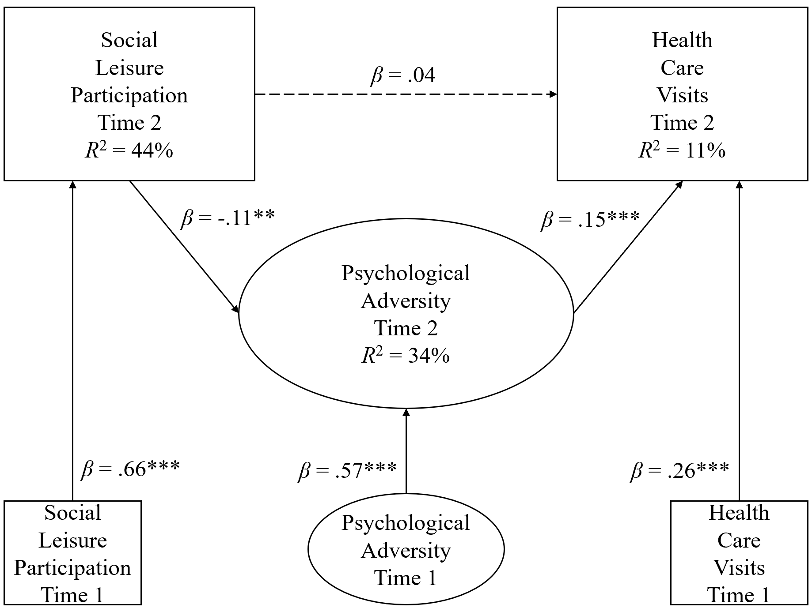
Results
H1: After accounting for time 1 reports of study variables, social leisure participation was significantly related to decreased psychological adversity, &, in turn psychological adversity was significantly related to health care visits
H2: Constrained & unconstrained path models were examined with an AMOS plugin using chi-square results to determine measurement invariance & results indicated there was no group moderation based on veteran status
(NFI=.94, CFI=.96, TLI=.94, rmsea=.03)
(Sobel test: z=-2.08, p<.05)
(Δχ²=186.36, Δdf=96, $∆_{critical}^{2}$ p=1.00)
Gaskin & Lim, 2018

Slide 10
Discussion
Higher levels of social leisure = lower psychological adversity
Higher psychological adversity = higher health care visits
Veteran status ≠ moderator between study variables
Suppositions from the findings are that social leisure participation facilitates social relationships…
Opportunity for individuals to receive social support to dissuade potential psychological adversity
Opportunity for social influence, by helping others identity mental health illnesses as they occur & encouraging health care visits
Among this sample, findings are relevant to older adults both veteran & civilian alike
Notes:
The purpose of this study was to investigate the role of social leisure participation in its association with psychological adversity & health care visits among older adults, with a specific interest in examining if differences between veterans & civilians existed

Slide 11
Limitations
Veteran status only asked if a person had prior military history
Future research could consider looking beyond military service & explore other military contexts (number of past deployments, traumatic experiences including combat exposure, military branch affiliation, etc.)
Leisure scale not an established measure
Continued validation is needed
Outcome variable chosen based on the extent of the frequency an individual reported seeking out health care services
Future research may consider using scales that investigate specific types of health care services as to better understand what types of services are used (e.g., walk-in clinics, emergency rooms, etc.)

Slide 12
Headline News
Socially supportive leisure environments are key to successful individual functioning for older adults
Volunteering
Participating in community organizations
Interacting with friends & family
So how do we help?
Promote social leisure as a mechanism that can be used in conjunction with formal support systems
Disseminate findings to community practitioners
Area Agency on Aging & Veteran Affairs
Promote open communication about mental health
Informal networks can encourage health care visits
family, friends, church groups, sports leagues, etc.

Slide 13
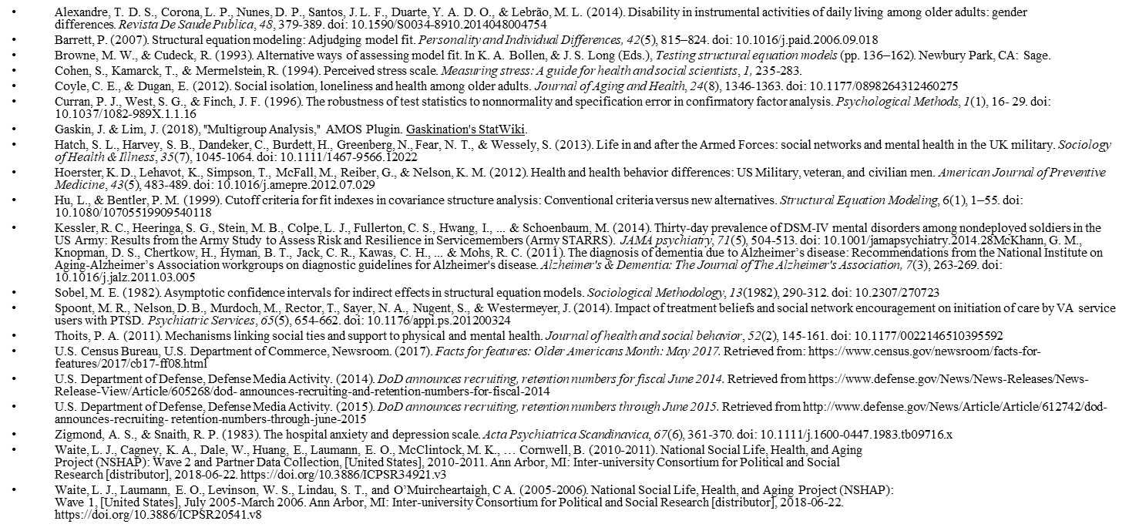
FRIENDS
of the
Tallgrass
University
of
Arkansas
Kansas
State
University
University
of
Iowa
References
NCFR
Ft. Worth Nov 2019

