Slide 1
Combat-Related Traumatic Experiences & Treatment Seeking Behaviors of Aging Veterans ____________________________________________________________________________________________________________________
Kansas
State
University
University
of
Arkansas
University
of
Iowa
Adelphi
University
Anthony J. Ferraro, Ph.D., CFLE, Kansas State University (aferraro@ksu.edu)
James M. Duncan, Ph.D., CFLE, DAV, University of Arkansas
Christina Marini, Ph.D., Aldelphi University
Shelbie N. McLain, Kansas State University
Kayla Reed-Fitzke, Ph.D., LMFT, University of Iowa
NCFR
Ft. Worth Nov 2019

Slide 2
Introduction
Prevalence of the aging veteran population (US DoD, 2015)
Combat-related traumatic experiences
Most consistent factor related to numerous negative health markers (Ramchand et al., 2015)
Health disparities
Sleep problems (Neylan et al., 1998)
Mental health (Grieger et al., 2006)
Notes:
Increasing aging pop
Increasing military pop (DOD, 2015) coupled with an aging US population speaks to prevalence
Combat-related traumatic experiences
Ramchand et al., 2015 - RAND’s review of risk factors and negative health issues faced by Iraq and Afghanistan veterans indicates that, although rates of PTSD and alcohol abuse vary widely across studies, combat exposure during deployment was the most consistent--and strongest--predictor of negative outcomes for military populations.
Elder and Clipp (1989) found that veterans exposed to high levels of combat (as opposed to low levels of combat or no combat) faced a greater risk of emotional and behavioral problems later in life.
Health Disparities
Sleep
Research with the Vietnam cohort indicates that sleep problems are strongly correlated with combat exposure (Neylan et al., 1997)
Almost half (41%) of service members deployed to Iraq or Afghanistan report sleep problems upon returning home (McLay, Klam, & Volkert, 2010)
Mental health
Service members who have greater exposure to (and intensity of) combat experiences have higher rates of anxiety, depression, and PTSD (Castro, 2009; Grieger et al., 2006)

Slide 3
Introduction
Prevalence of the aging veteran population
Combat-related traumatic experiences
Health disparities
Likelihood of seeking treatment/receiving treatment
Relationships with important others (Weiner et al., 2016)
Stigma (Spoont et al., 2014; Stecker et al., 2007)
Inadequate number receiving treatment (Hom et al., 2017; Lu et al., 2011)
Notes:
Likelihood of Seeking Treatment
Veterans who had both family members and other veterans encouraging them to seek out treatment, they were 1.87 times more likely to seek treatment than those who were not encouraged (Spoont et al., 2014)
Several barriers have been identified, including structural constraints (e.g., location of treatment facility; Hynes et al., 2007), interpersonal constraints (e.g., poor family cohesion, Tsai et al., 2012), and intrapersonal constraints (e.g., stigma about help seeking, Stecker et al., 2007)
Only approximately 55,300 service members (29% of military personnel across 11 studies) who reported having a recent mental health issue chose to utilize mental health services and receive care for their issues (Hom et al., 2017)

Slide 4
Framework
Stress Process Framework
Prior traumatic experiences as stressors (Pearlin et al., 1981)
Impact felt across time through the process of stress proliferation (Pearlin, 1989)
Use of resources & healthy coping (Pearlin et al., 1981)
Theory of Planned Behavior (Ajzen, 1991)
Understanding motivations through intention:
Perceived behavior control
Subjective norms
Attitudes

Slide 5
Current Study
Amongst aging veterans,…
are combat-related traumatic events linked with elevated mental and physical health conditions?
what relationship exists between the presence of mental and physical health conditions and the use of healthy (e.g., seeking treatment for conditions) and unhealthy (e.g., alcohol use) coping strategies?
what is the relationship between closeness to other veterans and the use of healthy and unhealthy coping strategies?

Slide 6
Sample
Secondary data from the Health & Retirement Study; repeated measures panel design
Data drawn from:
Veteran Mail Survey (2013)
Core (2014)
Core (2016)
Analytic Sample (n = 1,479)
On average 75 years old (SD = 9.79)
Predominately White (81%), Married (67%), and Male (96%)

Slide 7
Measures
Coping strategies
Treatment for depression or emotional problems [2016]
Treatment for sleep problems [2016]
Alcohol use [2016]
“Do you now get psychiatric or psychological treatment for your problems?”
“In the past year have you had any treatments for your [sleep/snoring] problem?”
Alcohol use (quantity/frequency)
“In the last three months, on average, how many days per week have you had any alcohol to drink?”
“In the last three months, on the days you drink, about how many drinks do you have?”

Slide 8
Measures
Coping strategies
Use of VA resources [2013]
“[Did you] obtain medical care or prescription drugs from a Veterans Affairs (VA) facility in the last two years”

Slide 9
Measures
Coping strategies
Use of VA resources
Health conditions
Perceived depression [2014]
Sleep problems [2014]
“During the last 12 months, was there ever a time when you felt sad, blue, or depressed for two weeks or more in a row”
E.g., “How often do you have trouble falling asleep”
Indicated Sometimes or Most of the Time

Slide 10
Measures
Coping strategies
Use of VA resources
Health conditions
Military Closeness [2013]
“How close do you feel towards your friends from the military?”
“How often do you help out your friends from the military?”
“How often do your friends from the military help you out?”

Slide 11
Measures
Coping strategies
Use of VA resources
Health conditions
Military Closeness
Combat-Related Traumatic Experiences (CRTE) [2013-Retro]
“Did you ever serve in a combat or war zone?”
“Were you ever exposed to dead, dying, or wounded people?”
“Were you ever exposed to environmental hazards such as Agent Orange, chemical warfare agents, ionizing radiation, or other potentially toxic substances?”

Slide 12
Measures
Coping strategies
Use of VA resources
Health conditions
Military Closeness
Combat-Related Traumatic Experiences (CRTE)
Covariates
Gender; Education; Race/Ethnicity; Widowed; Divorced/Separated

Slide 13
Analytic Plan
Missing data analysis
Measurement model
Structural model
Monte Carlo method for assessing mediation

Slide 14
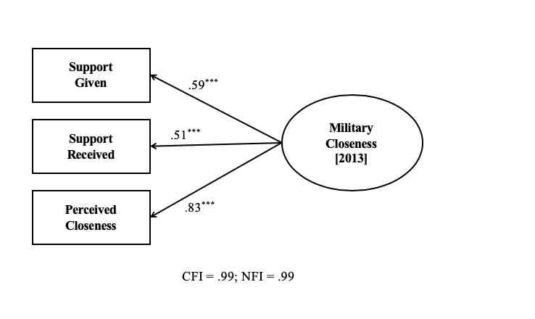
Preliminary Results
MCAR (χ² = 146.40, p = .55)
Measurement model

Slide 15
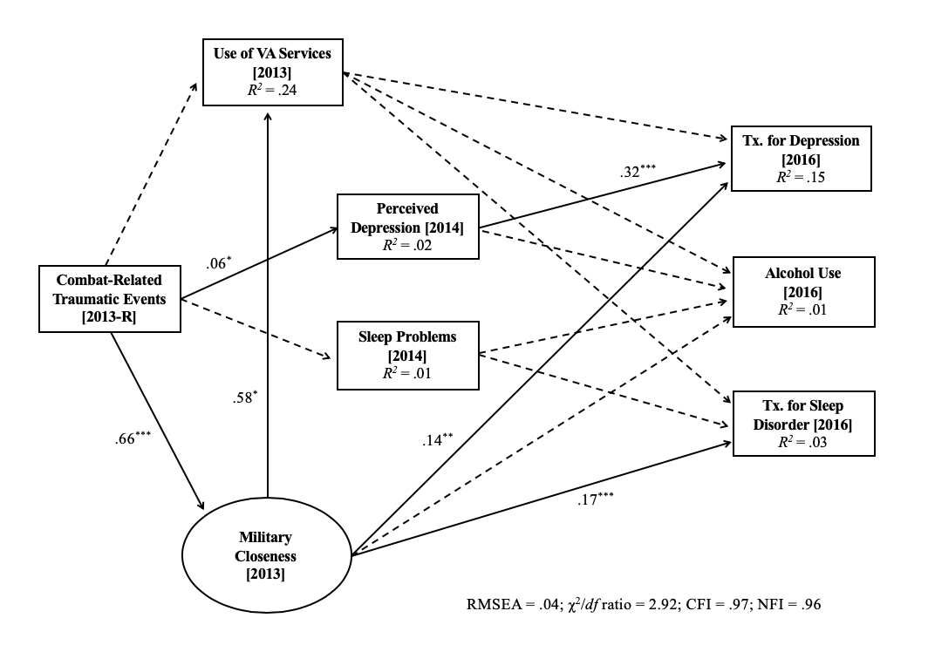
Results

Slide 16
Results
Test for indirect effects
Closeness (through Use of VA Services)
➡️ Tx. Sleep Disorder ❌
➡️ Tx. Depression ❌
➡️ Tx. Alcohol Use ❌
No Indirect
Effects Detected

Slide 17
Results
Test for indirect effects
Closeness (through Use of VA Services)
CRTE ➡️ Use of VA Services (through Closeness) ✅
CRTE (through Closeness)
➡️ Tx. Sleep Disorder ✅
➡️ Tx. Depression ✅
➡️ Tx. Alcohol Use ❌
That’s More Like It!

Slide 18
Future Considerations
ANOVA with Bonferroni post hoc tests
IV = Frequency of Contact
DV = Composite of Military Closeness
 | Never | Hardly ever | A few times a year | At least once a month
n | 820 | 257 | 195 | 153
M | 1.11 | 1.47 | 1.94 | 2.48
F | 602.27***
Note. All levels of frequency varied significantly from each other

Slide 19
Discussion
Closeness to fellow veterans as a protective factor for veterans that have chronic health conditions
The relationship between CRTE and social bonding may reflect a shared experience; as such, there is theoretical likelihood that veterans with CRTE will lean on these relationships more heavily (Ajzen, 1985)
Peripheral ties may be an important aspect to long term health, particularly for this cohort of veterans
Limitations & Future Directions: more robust measurement; longer term impacts over more data points

Slide 20
So What?
Interventions might consider ways to increase communication between veterans, as the frequency of communication is significantly linked with perceptions of closeness
Closeness is not only related to treatment seeking behaviors but also to use of VA services; policy-makers might consider the importance of building social networks of veterans as a leverage point to get veterans “in the door”
Stigma represents a major component surrounding treatment seeking behaviors and a culture that emphasizes the importance of health services may yield healthier aging veterans

Slide 21
Kansas
State
University
University
of
Arkansas
University
of
Iowa
Adelphi
University
References
Ajzen, I. (1985). From intentions to actions: A theory of planned behavior. In J. Kuhl, & J. Beckmann (Eds.), Action control: From cognition to behavior (pp. 11-
39). Berlin, Germany: Springer-Verlag.
Ajzen, I. (1991). The Theory of Planned Behavior. Organizational Behavior and Human Decision Processes, 50, 179-211.
Grieger, T. A., Cozza, S. J., Ursano, R. J., Hoge, C., Martinez, P. E., Engel, C., & Wain, H. J. (2006). Posttraumatic stress disorder and depression in battle-
injured soldiers. American Journal of Psychiatry, 163, 1777–1783.
Hom, M. A., Stanley, I. H., Schneider, M. E., & Joiner Jr, T. E. (2017). A systematic review of help-seeking and mental health service utilization among military
service members. Clinical Psychology Review, 53, 59-78.
Lu, M. W., Duckart, J. P., O'Malley, J. P., & Dobscha, S. K. (2011). Correlates of utilization of PTSD specialty treatment among recently diagnosed veterans at
the VA. Psychiatric Services, 62(8), 943-949.
Neylan, T. C., Marmar, C. R., Metzler, T. J., Weiss, D. S., Zatzick, D. F., Delucchi, K. L., Wu, R. M., & Schoenfeld, F. B. (1998). Sleep disturbances in the
Vietnam generation: Findings from a nationally representative sample of male Vietnam veterans. American Journal of Psychiatry, 155(7), 929-933.
Pearlin, L. I. (1989). The sociological study of stress. Journal of Health and Social Behavior, 30, 241-256.
Pearlin, L. I., Menaghan, E. G., Lieberman, M. A., & Mullan, J. T. (1981). The stress process. Journal of Health & Social Behavior, 22(4), 337-356.
Ramchand, R., Rudavsky, R., Grant, S., Tanielian, T., & Jaycox, L. (2015). Prevalence of, risk factors for, and consequences of posttraumatic stress disorder and
other mental health problems in military populations deployed to Iraq and Afghanistan. Current Psychiatry Reports, 17(5), 37.
Spoont, M. R., Nelson, D. B., Murdoch, M., Rector, T., Sayer, N. A., Nugent, S., & Westermeyer, J. (2014). Impact of treatment beliefs and social network
encouragement on initiation of care by VA service users with PTSD. Psychiatric Services, 65(5), 654-662.
Stecker, T., Fortney, J. C., Hamilton, F., & Ajzen, I. (2007). An assessment of beliefs about mental health care among veterans
who served in Iraq. Psychiatric Services, 58, 1358-1361.
U.S. Department of Defense, Defense Media Activity. (2015). DoD announces recruiting, retention numbers through June
2015. Retrieved from http://www.defense.gov/News/Article/Article/612742
Weiner, M. R., Monin, J. K., Mota, N., & Pietrzak, R. H. (2016). Age differences in the association of social support and
mental health in male US Veterans: Results from the National Health and Resilience in Veterans Study. The American
Journal of Geriatric Psychiatry, 24(4), 327-336.
NCFR
Ft. Worth Nov 2019

