Slide 1
Community-Based Sampling Techniques: Leveraging Available Archival Data to Drive Research
Anthony J. Ferraro, PhD, CFLE
Kansas State University
Hilary Dalton, MS
Kansas State University
James M. Duncan, PhD, CFLE
University of Arkansas
Shelby T. Boso
Kansas State University
NCFR San Diego, CA
November, 2018

Slide 2
LTC-A Background
The transition to LTC is a critical time for aging individuals as they leave their families and communities and prepare to enter institutionalized living environments
LTC = institutionalized living (Assisted Living Facilities/Nursing Homes)
Although these older adults are provided with professional care, research suggests that LTC residents are at greater risk for ill-being compared to non-institutionalized peers¹
This study sought to determine how leisure activities impact outcomes among older adults in LTC
¹Duncan et al., 2017; Kim et al., 2006; Mezuk et al., 2008

Slide 3
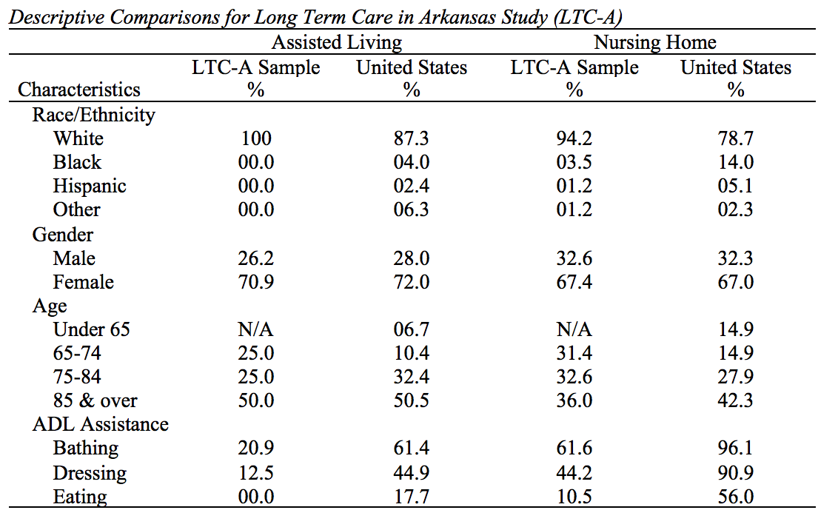
U.S. data drawn from the 2013 National Study of Long-Term Care Providers²
LTC-A Sample
Those under 65 years of age were not recruited for LTC-A
N = 110
Cross-Sectional
13 LTC facilities in Western Arkansas
Data Collected in 2013-2014
M LTC residency = 27 months
Facilities recommended by the Area Agency on Aging
Activity directors served as liaisons between part./PI
Screening using the Mini-Mental State Examination used to assess cognitive abilities
²US DHHS, 2013

Slide 4
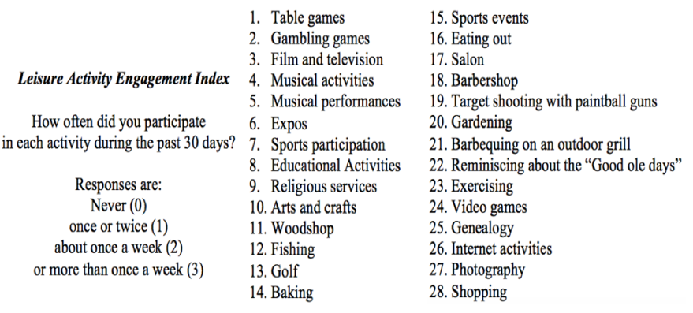
LTC-A Instrumentation

Slide 5
PAD Background
Wide-reaching social and legal changes in the context of divorce for parents and children³
Reliance on outdated data and perceptions to inform divorce education⁴
Better understanding the connection between father identity, father involvement, and well-being (both for parents and children) in the time immediately following a divorce
Important period of reorganization following divorce
³Kohm, 2008
⁴Nielsen, 2013

Slide 6
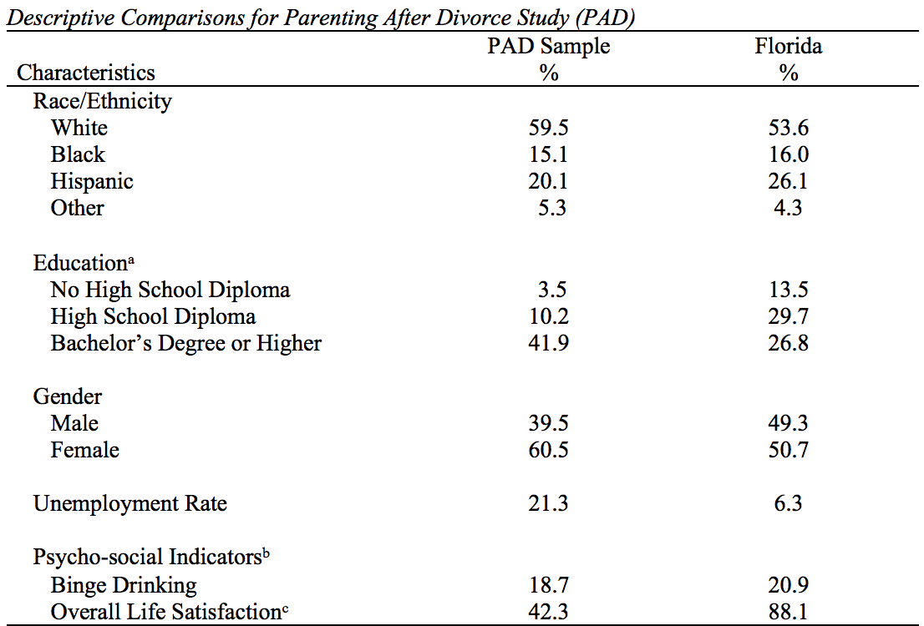
PAD Sample
State-level markers identify those age 25 and older, that have attained each degree⁵
State-level markers are from 2013 and include all citizens not married/coupled
-N = 294
-Longitudinal (3 waves)
-4 large counties in Florida
-Data Collected in 2014-2015
Identification through county court records
Surveys sent through mail with response envelopes and noncontingent incentives enclosed
Ability to take survey online or return paper survey
⁵FDH, 2018

Slide 7
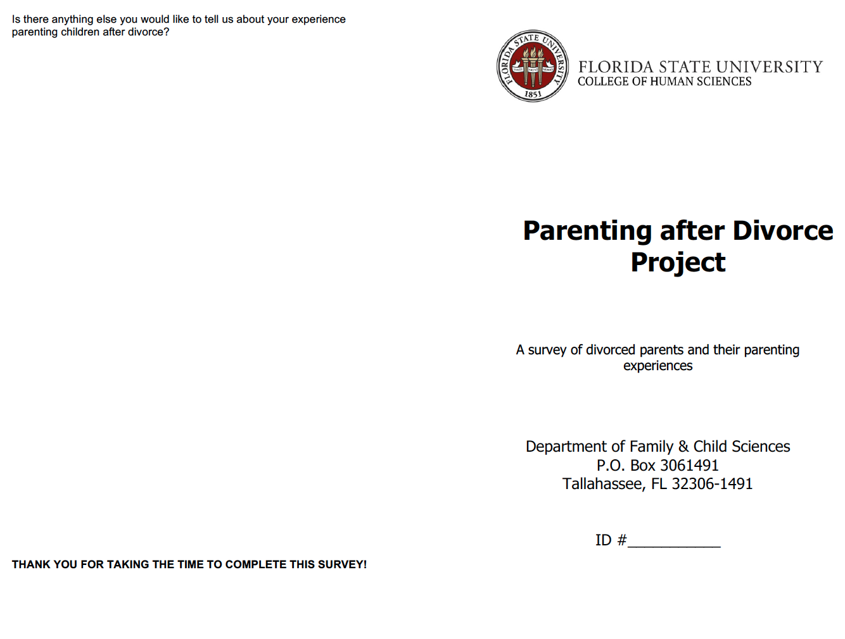
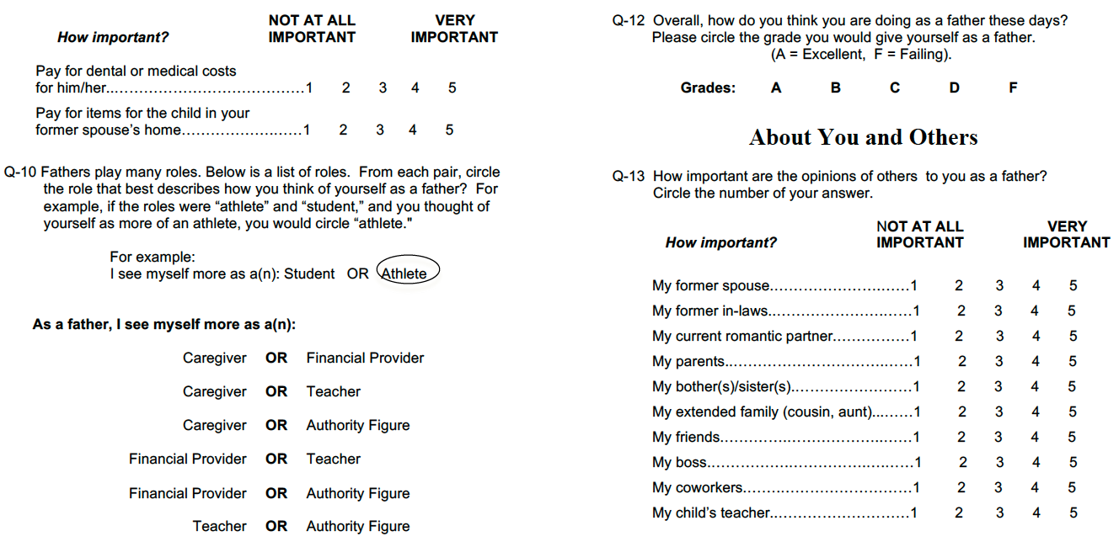
PAD Instrumentation

Slide 8
CAH Background
Most co-parenting research focuses on married or divorced parents exclusively⁶
This notably omits parents that have never had a marital relationship yet share minor children, a growing trend
There are differences between unmarried and divorced parents that need to be accounted for⁷
Sought to determine how ambient stressors associated with co-parenting across diverse contexts impacts parental and child well-being
⁶Bryan, 2013; Vosler & Robertson, 1998
⁷Dudley, 2007; Jamison et al., 2017; Vosler & Robertson, 1998

Slide 9
Kansas data drawn from Missouri Census Data Center⁸
CAH Sample Characteristics
CAH sampling frame data is drawn from court records and represents a valid %
-N = 179
-Cross sectional
-2 rural counties in Kansas
-Data Collected in 2018 from court filings 2015-2017 involving child’s other parent
Identification through court records from 2 counties
Invitations to participate sent through mail with survey link and noncontingent incentive enclosed
Ability to take survey online from phone or computer
CAH sampling frame children are total shared children
⁸Missouri Census Data Center

Slide 10
CAH Instrumentation

Slide 11
Benefits of Primary Data Collection
Ex. Using the Role Salience Scale adapted and specified to account for fathering roles⁹ [PAD]
Ex. Scale development for a new measure of sacrifice that fills gaps in the broader literature [CAH]
Allows for the an overarching theoretical lens from which to examine phenomena
Allows for selection of specific & precise instrumentation
Use of strict inclusion criteria to answer specific questions about specific populations
Allows for community relationships and stakeholder “buy-in”
Ex. Divorced with minor child; divorced within 3 months prior; filed within 9 months [PAD]
Ex. Working with community organizations to identify participants [LTC-A]
⁹Inhinger-Tallman et al., 1993; Serpe, 1987

Slide 12
To-Do List with Primary Data Collection
Make goals – Use a timeline – Be realistic and flexible – Expect delays
Determine collection method based on sample characteristics and abilities
Create an organizational system for documents
Keep all records regardless of perceived importance
Understand terminology related to sampling method and frame (e.g., legal terminology when identifying through court records)
Use resources (e.g., research databases, community connections)
Communicate with your team

Slide 13
Roundtables
Measures
Pro/con create own vs compiling previous
Scale development
Sample identification
Inclusion/exclusion criteria
Identifying existing data – can you use this?
Crafting a survey
Display logic
Paper vs online survey

Slide 14
References
Bryan, D. M. (2013). To parent or provide? The effect of the provider role on low-income men’s decisions about fatherhood and paternal engagement. Fathering, 11, 71-89.
Dudley, J. R. (2007). Helping nonresidential fathers: The case for teen and adult unmarried fathers. Families in Society, 88(2), 171-181.
Duncan, J. M., Killian, T. S., & Lucier-Greer, M. (2017). Leisure, relatedness, & ill-being among older adults in long-term care. Activities, Adaptation & Aging, 41(4), 273-290.
Florida Department of Health, Division of Public Health Statistics & Performance Management (2018). Florida Charts [Database]. Retrieved from: www.flhealthcharts.com/
Ihinger-Tallman, M., & Pasley, K. & Buehler, C. (1993). Developing a middle-range theory of father involvement postdivorce. Journal of Family Issues, 14(4), 550-570.
Jamison, T. B., Ganong, L., & Proulx, C. M. (2017). Unmarried coparenting in the context of poverty: Understanding the relationship between stress, family resource management, and resilience. Journal of Family and Economic Issues, 38, 439-452.
Kim, S. Y., Jeon, E. Y., Sok, S. R., & Kim, K. B. (2006). Comparison of health-promoting behaviors of noninstitutionalized and institutionalized older adults in Korea. Journal of Nursing Scholarship, 38(1), 31–35.
Kohm, L. M. (2008). Tracing the foundations of the best interests of the child standard in American jurisprudence. Journal of Law & Family Studies, 10, 337-376.
Mezuk, B., Prescott, M. R., Tardiff, K., Vlahov, D., & Galea, S. (2008). Suicide in older adults in long-term care: 1990 to 2005. Journal of the American Geriatrics Society, 56(11), 2107– 2111.
Missouri Census Data Center. (2018). ACS Profiles [dataset application]. Available from https://census.missouri.edu/acs/profiles/
National Center for Health Statistics (2017). Unmarried childbearing. Retrieved from https://www.cdc.gov/nchs/fastats/unmarried-childbearing.htm
Nielsen, L. (2013). Shared residential custody: Review of the research (Part I of II). American Journal of Family Law, 27, 61–77.
Serpe, T. R. (1987). Stability and change in self: A structural symbolic interactionist explanation. American Sociological Association, 50(1), 44-55.
U.S. Department of Health and Human Services (DHHS; 2013). Long-term care services in the United States: 2013 overview (Publication No. 2014–1040). Vital and Health Statistics Series, 3(37), 1–93.
Volser, N. R., & Robertson, J. G. (1998). Nonmarital co-parenting: Knowledge building for practice. Families in Society, 79(2), 149-159.

Slide 15
A sincere thank you to all those that assisted in the collection/analysis of the data for the studies described in this workshop, as well as our generous funders
For more information please contact:
Co-Parenting Across Households
Hilary Dalton
Kansas State University
dhilary@ksu.edu
Parenting After Divorce
Anthony J. Ferraro
Kansas State University
aferraro@ksu.edu
Long-Term Care in Arkansas
James M. Duncan
University of Arkansas
jmduncan@uark.edu
Shelby T. Boso
McKenzie L. Cox
Hilary Dalton
Taylor R. Davis
James M. Duncan
Anthony J. Ferraro
Megan E. Fry
Timothy Killian
Shelbie L. McLain
B. Kay Pasley
Priyanka J. Patel
Raymond E. Petren
Merani Rivarola
Renee Wilkins-Clark

